Slide 1
Processes

Slide 2
Processes
Process Concept
Process Scheduling
Operations on Processes
Interprocess Communication
Examples of IPC Systems
Communication in Client-Server Systems

Slide 3
Objectives
To introduce the notion of a process -- a program in execution, which forms the basis of all computation
To describe the various features of processes, including scheduling, creation and termination, and communication
To describe communication in client-server systems

Slide 4
Process Concept
An operating system executes a variety of programs:
  Batch system – jobs
  Time-shared systems – user programs or tasks
Textbook uses the terms job and process almost interchangeably
Process – a program in execution; process execution must progress in sequential fashion
A process includes:
  program counter
  stack
  data section

Slide 5
The Process
Multiple parts
  The program code, also called text section
  Current activity including program counter, processor registers
  Stack containing temporary data
    Function parameters, return addresses, local variables
  Data section containing global variables
  Heap containing memory dynamically allocated during run time
Program is passive entity, process is active
  Program becomes process when executable file loaded into memory
Execution of program started via GUI mouse clicks, command line entry of its name, etc
One program can be several processes
  Consider multiple users executing the same program

Slide 6
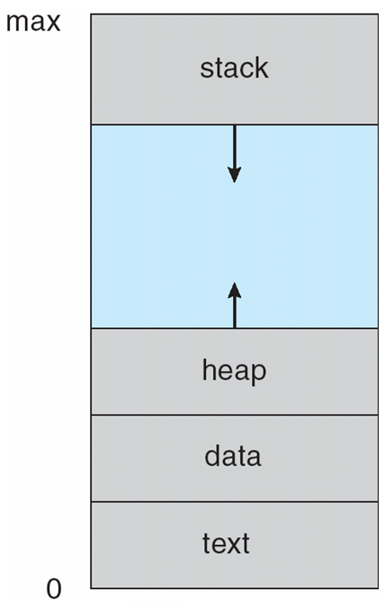
Process in Memory

Slide 7
Process State
As a process executes, it changes state
  new: The process is being created
  running: Instructions are being executed
  waiting: The process is waiting for some event to occur
  ready: The process is waiting to be assigned to a processor
  terminated: The process has finished execution

Slide 8

Diagram of Process State

Slide 9
Process Control Block (PCB)
Information associated with each process
Process state
Program counter
CPU registers
CPU scheduling information
Memory-management information
Accounting information
I/O status information

Slide 10

Process Control Block (PCB)

Slide 11

CPU Switch From Process to Process

Slide 12
Process Scheduling
Maximize CPU use, quickly switch processes onto CPU for time sharing
Process scheduler selects among available processes for next execution on CPU
Maintains scheduling queues of processes
  Job queue – set of all processes in the system
  Ready queue – set of all processes residing in main memory, ready and waiting to execute
  Device queues – set of processes waiting for an I/O device
  Processes migrate among the various queues

Slide 13
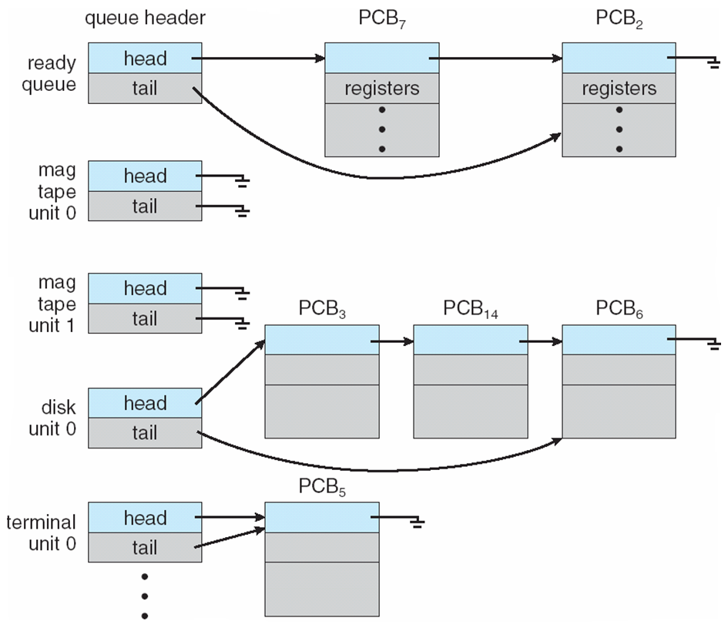
Ready Queue And Various
I/O Device Queues

Slide 14
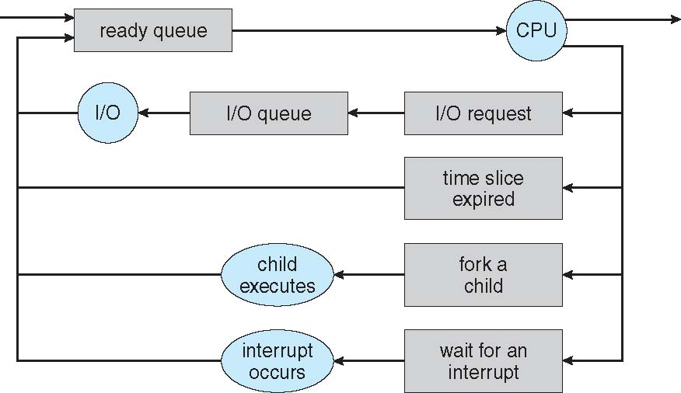
Representation of Process Scheduling

Slide 15
Schedulers
Long-term scheduler (or job scheduler) – selects which processes should be brought into the ready queue
Short-term scheduler (or CPU scheduler) – selects which process should be executed next and allocates CPU
  Sometimes the only scheduler in a system

Slide 16
Schedulers (Cont.)
Short-term scheduler is invoked very frequently (milliseconds) ⇒ (must be fast)
Long-term scheduler is invoked very infrequently (seconds, minutes) ⇒ (may be slow)
The long-term scheduler controls the degree of multiprogramming
Processes can be described as either:
  I/O-bound process – spends more time doing I/O than computations, many short CPU bursts
  CPU-bound process – spends more time doing computations; few very long CPU bursts

Slide 17
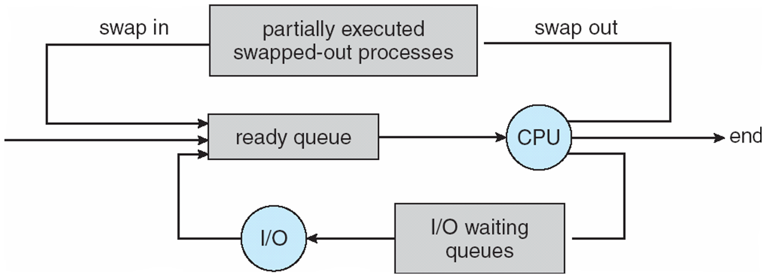
Addition of Medium Term Scheduling

Slide 18
Context Switch
When CPU switches to another process, the system must save the state of the old process and load the saved state for the new process via a context switch.
Context of a process represented in the PCB
Context-switch time is overhead; the system does no useful work while switching
  The more complex the OS and the PCB -> longer the context switch
Time dependent on hardware support
  Some hardware provides multiple sets of registers per CPU -> multiple contexts loaded at once

Slide 19
Process Creation
Parent process create children processes, which, in turn create other processes, forming a tree of processes
Generally, process identified and managed via a process identifier (pid)
Resource sharing
  Parent and children share all resources
  Children share subset of parent’s resources
  Parent and child share no resources
Execution
  Parent and children execute concurrently
  Parent waits until children terminate

Slide 20
Process Creation (Cont.)
Address space
  Child duplicate of parent
  Child has a program loaded into it
UNIX examples
  fork system call creates new process
  exec system call used after a fork to replace the process’ memory space with a new program

Slide 21
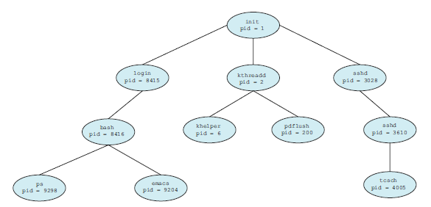
A Tree of Processes

Slide 22
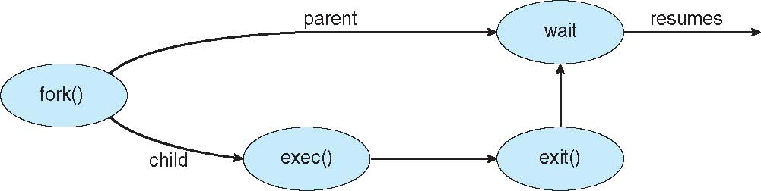
Process Creation

Slide 23
C Program Forking Separate Process
#include <sys/types.h>
#include <studio.h>
#include <unistd.h>
int main()
{
pid_t pid;
/* fork another process */
pid = fork();
if (pid < 0) { /* error occurred */
fprintf(stderr, "Fork Failed");
return 1;
}
else if (pid == 0) { /* child process */
execlp("/bin/ls", "ls", NULL);
}
else { /* parent process */
/* parent will wait for the child */
wait (NULL);
printf ("Child Complete");
}
return 0;
}

Slide 24
Process Termination
Process executes last statement and asks the operating system to delete it (exit)
  Output data from child to parent (via wait)
  Process’ resources are deallocated by operating system
Parent may terminate execution of children processes (abort)
  Child has exceeded allocated resources
  Task assigned to child is no longer required
  If parent is exiting
    Some operating systems do not allow child (orphan child) to continue if its parent terminates
      All children terminated - cascading termination
      A process that has terminated, but whose parent has not yet called wait(), is known as a zombie process.

Slide 25
Interprocess Communication
Processes within a system may be independent or cooperating
Cooperating process can affect or be affected by other processes, including sharing data
Reasons for cooperating processes:
  Information sharing
  Computation speedup
  Modularity
  Convenience
Cooperating processes need interprocess communication (IPC)
Two models of IPC
  Shared memory
  Message passing

Slide 26
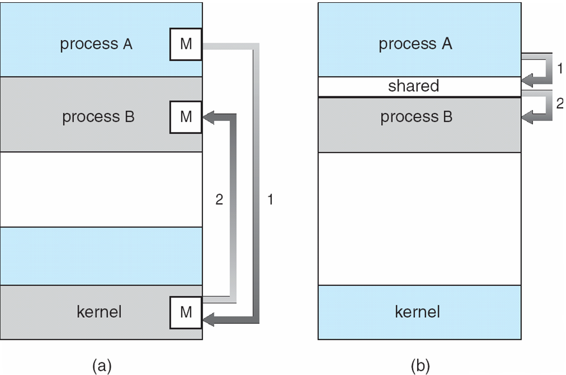
Communications Models

Slide 27
Cooperating Processes
Independent process cannot affect or be affected by the execution of another process
Cooperating process can affect or be affected by the execution of another process
Advantages of process cooperation
  Information sharing
  Computation speed-up
  Modularity
  Convenience

Slide 28
Producer-Consumer Problem
Paradigm for cooperating processes, producer process produces information that is consumed by a consumer process
  unbounded-buffer places no practical limit on the size of the buffer
  bounded-buffer assumes that there is a fixed buffer size

Slide 29
Bounded-Buffer –
Shared-Memory Solution
Shared data
      #define BUFFER_SIZE 10
      typedef struct {
      . . .
      } item;
      item buffer[BUFFER_SIZE];
      int in = 0;
      int out = 0;
Solution is correct, but can only use BUFFER_SIZE-1 elements

Slide 30
Bounded-Buffer – Producer
while (true) {
/* Produce an item */
while (((in = (in + 1) % BUFFER SIZE) == out)
; /* do nothing -- no free buffers */
buffer[in] = item;
in = (in + 1) % BUFFER SIZE;
}

Slide 31
Bounded Buffer – Consumer
while (true) {
while (in == out)
; // do nothing -- nothing to consume
// remove an item from the buffer
item = buffer[out];
out = (out + 1) % BUFFER SIZE;
return item;
}

Slide 32
Interprocess Communication –
Message Passing
Mechanism for processes to communicate and to synchronize their actions
Message system – processes communicate with each other without resorting to shared variables
IPC facility provides two operations:
  send(message) – message size fixed or variable
  receive(message)
If P and Q wish to communicate, they need to:
  establish a communication link between them
  exchange messages via send/receive
Implementation of communication link
  physical (e.g., shared memory, hardware bus)
  logical (e.g., logical properties)

Slide 33
Implementation Questions
How are links established?
Can a link be associated with more than two processes?
How many links can there be between every pair of communicating processes?
What is the capacity of a link?
Is the size of a message that the link can accommodate fixed or variable?
Is a link unidirectional or bi-directional?

Slide 34
Direct Communication
Processes must name each other explicitly:
  send (P, message) – send a message to process P
  receive(Q, message) – receive a message from process Q
Properties of communication link
  Links are established automatically
  A link is associated with exactly one pair of communicating processes
  Between each pair there exists exactly one link
  The link may be unidirectional, but is usually bi-directional

Slide 35
Indirect Communication
Messages are directed and received from mailboxes (also referred to as ports)
  Each mailbox has a unique id
  Processes can communicate only if they share a mailbox
Properties of communication link
  Link established only if processes share a common mailbox
  A link may be associated with many processes
  Each pair of processes may share several communication links
  Link may be unidirectional or bi-directional

Slide 36
Indirect Communication
Operations
  create a new mailbox
  send and receive messages through mailbox
  destroy a mailbox
Primitives are defined as:
send(A, message) – send a message to mailbox A
receive(A, message) – receive a message from mailbox A

Slide 37
Indirect Communication
Mailbox sharing
  P₁, P₂, and P₃ share mailbox A
  P₁, sends; P₂ and P₃ receive
  Who gets the message?
Solutions
  Allow a link to be associated with at most two processes
  Allow only one process at a time to execute a receive operation
  Allow the system to select arbitrarily the receiver. Sender is notified who the receiver was.

Slide 38
Synchronization
Message passing may be either blocking or non-blocking
Blocking is considered synchronous
  Blocking send has the sender block until the message is received
  Blocking receive has the receiver block until a message is available
Non-blocking is considered asynchronous
  Non-blocking send has the sender send the message and continue
  Non-blocking receive has the receiver receive a valid message or null

Slide 39
Buffering
Queue of messages attached to the link; implemented in one of three ways
  1. Zero capacity – 0 messages
  Sender must wait for receiver (rendezvous)
  2. Bounded capacity – finite length of n messages
  Sender must wait if link full
  3. Unbounded capacity – infinite length
  Sender never waits

Slide 40
Communications in Client-Server Systems
Sockets
Remote Procedure Calls
Pipes
Remote Method Invocation (Java)

Slide 41
Sockets
A socket is defined as an endpoint for communication
Concatenation of IP address and port
The socket 161.25.19.8:1625 refers to port 1625 on host 161.25.19.8
Communication consists between a pair of sockets

Slide 42
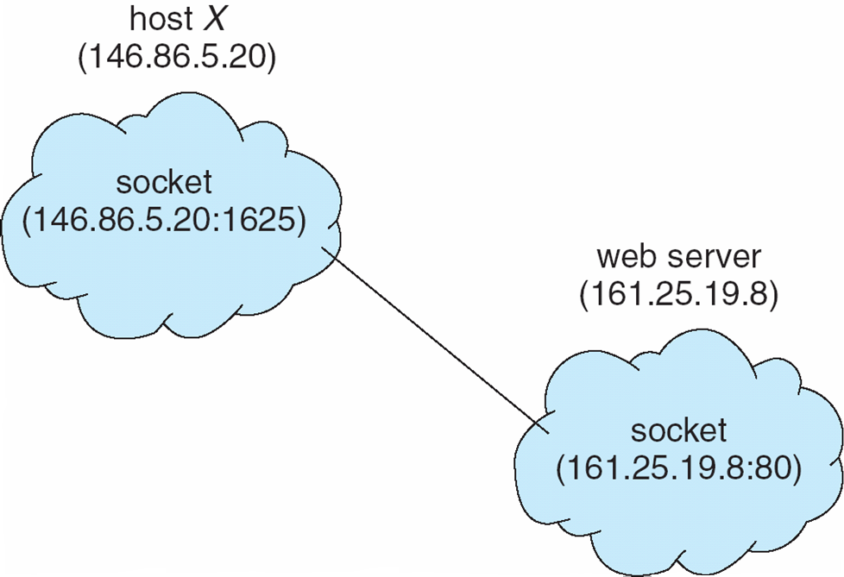
Socket Communication

Slide 43
Remote Procedure Calls
Remote procedure call (RPC) abstracts procedure calls between processes on networked systems
Stubs – client-side proxy for the actual procedure on the server
The client-side stub locates the server and marshalls the parameters
The server-side stub receives this message, unpacks the marshalled parameters, and performs the procedure on the server

Slide 44
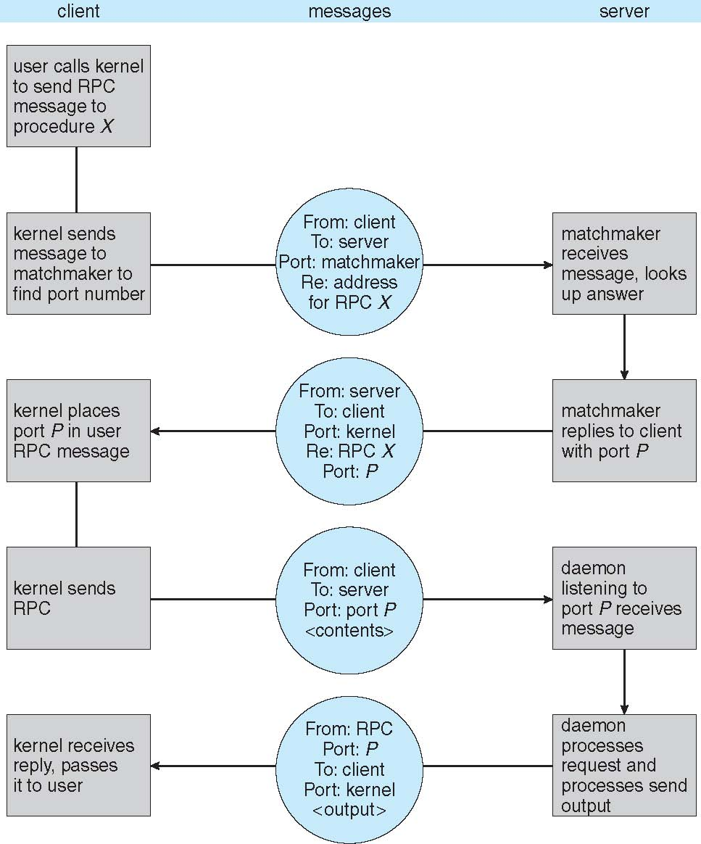
Execution of RPC

Slide 45
Pipes
Acts as a conduit allowing two processes to communicate
Issues
  Is communication unidirectional or bidirectional?
  In the case of two-way communication, is it half or full-duplex?
  Must there exist a relationship (i.e. parent-child) between the communicating processes?
  Can the pipes be used over a network?

Slide 46
Ordinary Pipes
Ordinary Pipes allow communication in standard producer-consumer style
Producer writes to one end (the write-end of the pipe)
Consumer reads from the other end (the read-end of the pipe)
Ordinary pipes are therefore unidirectional
Require parent-child relationship between communicating processes

Slide 47
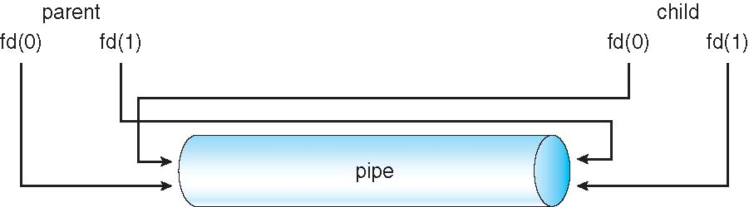
Ordinary Pipes

Slide 48
Named Pipes
Named Pipes are more powerful than ordinary pipes
Communication is bidirectional
No parent-child relationship is necessary between the communicating processes
Several processes can use the named pipe for communication
Provided on both UNIX and Windows systems

